Slide 1
Democratic Competition III: Electoral Systems
POL1036: Comparative European Politics – Lecture 13
19/03/2026

Slide 2
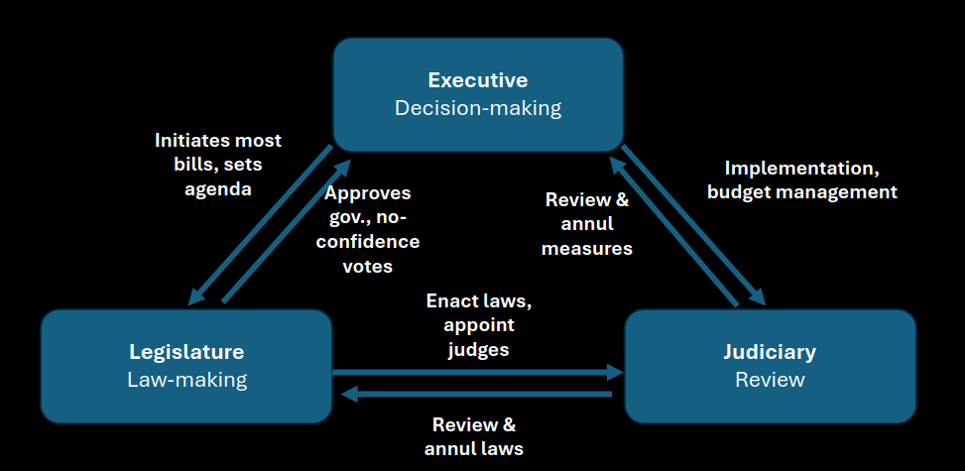
Institutions
Parliament & Government
Electoral system
Seeking Office
Individuals
Voters
Vote based on political culture
Groups
Parties
Seeking Votes
Democratic Competition

Slide 3
Recap: Origin of Party systems
Fragmentation?
#Parties
Polarization?
Ideological distance
Electoral System
Cleavages
(Party Families)

Slide 4
Electoral systems are categorised based on their electoral formula, or how they transfer votes into seats.

Slide 5
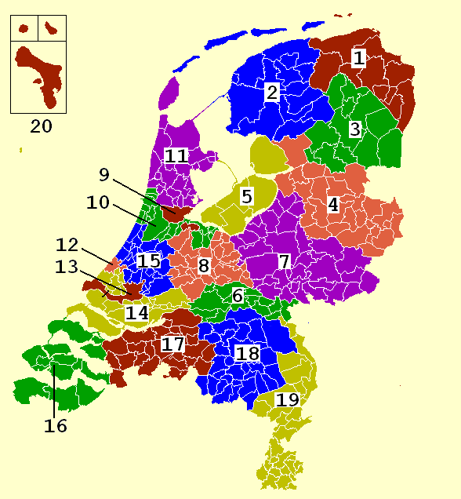
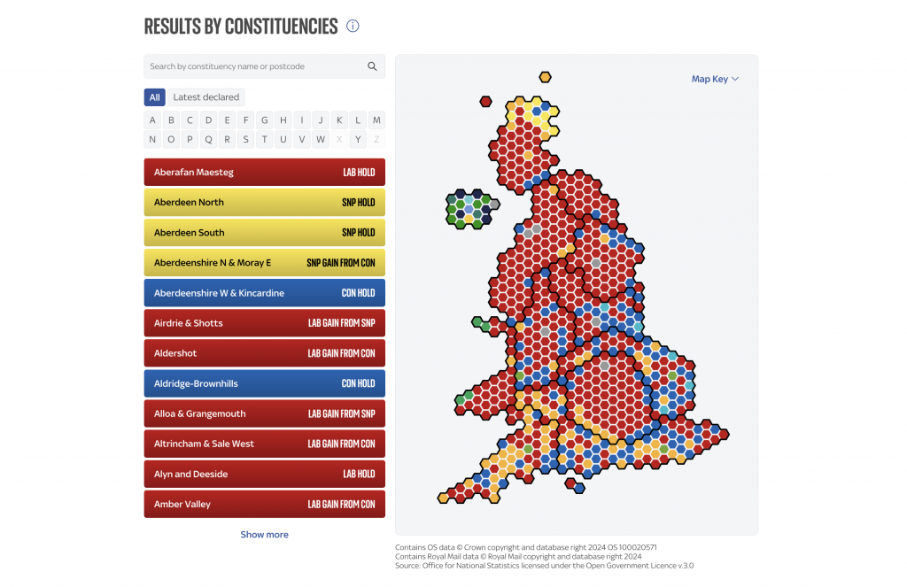
Key Concepts
District Magnitude (DM): Average #seats per electoral district
UK: DM 1, 700K inhabitants/ district
NL: DM 150 (despite 20 electoral districts)

Slide 6
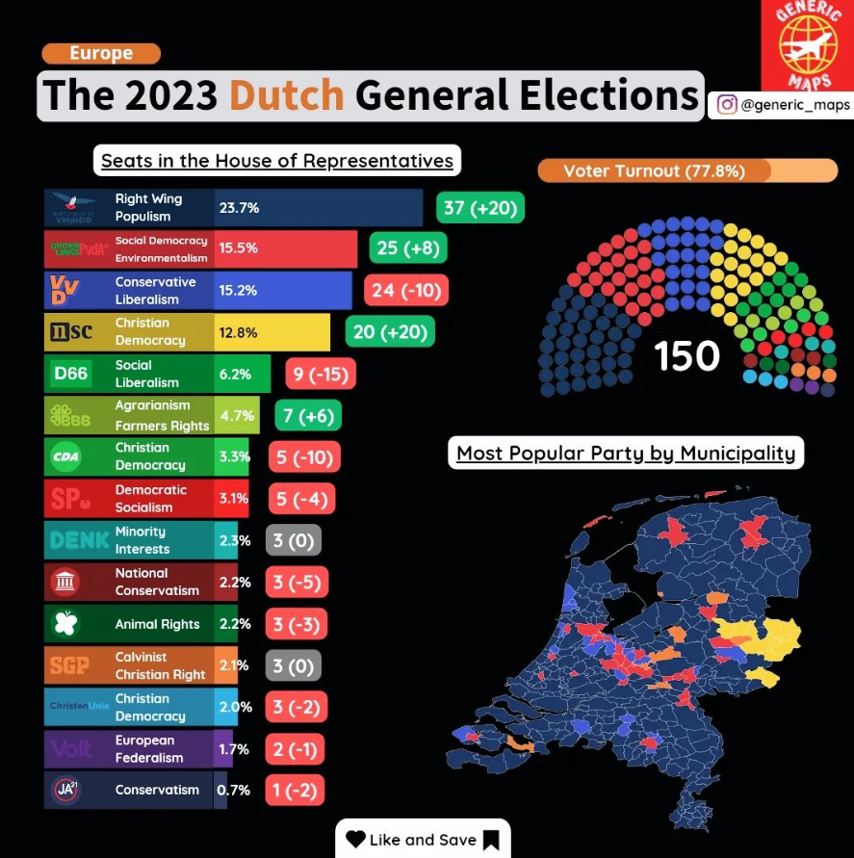

Slide 7
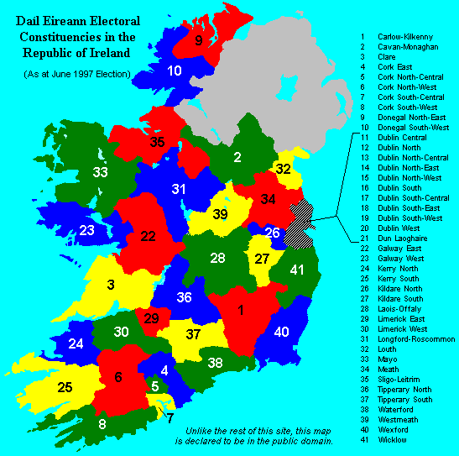
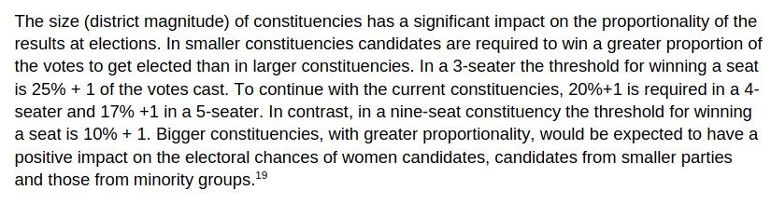
Key Concepts
District Magnitude (DM): Average #seats per electoral district
Oireachtas Library & Research Service, 2023. L&RS Bill Digest: Electoral (Amendment) Bill 2023. Bill No. 77 of 2023
https://data.oireachtas.ie/ie/oireachtas/libraryResearch/2023/2023-11-21_bill-digest-electoral-amendment-bill-2023_en.pdf
Ireland: MD just over 4 since 2023 (3-5 seats per constituency)

Slide 8

Key Concepts
District Magnitude (DM)
(Dis)Proportionality: Extent to which an electoral system is bad/good at representing the proportions within society
Gallagher index (Michael Gallagher, 1992)
Low scores = proportional, high scores = disproportional
Vi = %votes, Si = %seats

Slide 9
Example: Ireland 2024
1
2
2024 election result | % vote | % seats | %v - %s | squared
Fianna Fáil | 21.86 | 27.17 | -5.31 | 28.1961
Fine Gael | 20.8 | 21.97 | -1.17 | 1.3689
Sinn Féin | 19.01 | 22.54 | -3.53 | 12.4609
Social Democrats | 4.81 | 6.36 | -1.55 | 2.4025
Labour | 4.65 | 6.36 | -1.71 | 2.9241
Aontú | 3.91 | 1.16 | 2.75 | 7.5625
Independent Ireland | 3.55 | 2.31 | 1.24 | 1.5376
Green Party | 3.04 | 0.58 | 2.46 | 6.0516
PBP–Solidarity (People Before Profit–Solidarity) | 2.84 | 1.73 | 1.11 | 1.2321
People Before Profit | 2.24 | 1.16 | 1.08 | 1.1664
Solidarity | 0.6 | 0.58 | 0.02 | 0.000400000000000001
Irish Freedom Party | 0.67 | 0 | 0.67 | 0.4489
The Irish People | 0.35 | 0 | 0.35 | 0.1225
100% Redress | 0.31 | 0.58 | -0.27 | 0.0729
National Party | 0.3 | 0 | 0.3 | 0.09
Independents 4 Change | 0.23 | 0 | 0.23 | 0.0529
Ireland First | 0.15 | 0 | 0.15 | 0.0225
Right to Change | 0.13 | 0 | 0.13 | 0.0169
Liberty Republic | 0.09 | 0 | 0.09 | 0.0081
Party for Animal Welfare | 0.04 | 0 | 0.04 | 0.0016
Rabharta | 0.03 | 0 | 0.03 | 0.0009
Centre Party | 0.02 | 0 | 0.02 | 0.0004
Independents | 13.2 | 9.25 | 3.95 | 15.6025
3. Sum of the squares: 81.3432
4. Half of the sum: 40.6716
5. Square root: 6.3774

Slide 10
Example 2: Netherlands 2025
Party | %votes | % Seats | %v - %s | squared
D66 | 16.94 | 17.3333333333333 | -0.393333333333334 | 0.154711111111112
PVV | 16.66 | 17.3333333333333 | -0.673333333333336 | 0.453377777777781
VVD | 14.24 | 14.6666666666667 | -0.426666666666666 | 0.182044444444444
GL-PvdA | 12.79 | 13.3333333333333 | -0.543333333333335 | 0.295211111111113
CDA | 11.79 | 12 | -0.210000000000001 | 0.0441000000000004
JA21 | 5.95 | 6 | -0.0499999999999998 | 0.00249999999999998
FvD | 4.54 | 4.66666666666667 | -0.126666666666667 | 0.0160444444444445
BBB | 2.65 | 2.66666666666667 | -0.0166666666666671 | 0.000277777777777791
Denk | 2.37 | 2 | 0.37 | 0.1369
SGP | 2.25 | 2 | 0.25 | 0.0625
PvdD | 2.08 | 2 | 0.0800000000000001 | 0.00640000000000001
CU | 1.9 | 2 | -0.1 | 0.01
SP | 1.89 | 2 | -0.11 | 0.0121
50 | 1.43 | 1.33333333333333 | 0.0966666666666665 | 0.0093444444444444
Volt | 1.1 | 0.666666666666667 | 0.433333333333333 | 0.187777777777778
3. Sum of the squares: 1.5732
4. Half of the sum: 0.7866
5. Square root: 0.8869

Slide 11
Example 3: UK 2024
Party | &vote | %seats | Difference | squared
Conservative Party | 23.7 | 18.6 | -5.1 | 26.01
Plaid Cymru | 0.7 | 0.6 | -0.1 | 0.01
Reform UK | 14.3 | 0.8 | -13.5 | 182.25
Alliance Party of Northern Ireland | 0.4 | 0.2 | -0.2 | 0.04
Sinn Féin | 0.7 | 1.1 | 0.4 | 0.16
Speaker | 0.1 | 0.2 | 0.1 | 0.01
Labour Party | 34.7 | 63.2 | 28.5 | 812.25
Scottish National Party | 2.5 | 1.4 | -1.1 | 1.21
Traditional Unionist Voice | 0.2 | 0.2 | 0 | 0
Democratic Unionist Party | 0.6 | 0.8 | 0.2 | 0.04
Liberal Democrats | 12.2 | 11.1 | -1.1 | 1.21
Ulster Unionist Party | 0.3 | 0.2 | -0.1 | 0.01
Social Democratic and Labour Party | 0.3 | 0.3 | 0 | 0
Green Party of England and Wales | 6.4 | 0.6 | -5.8 | 33.64
Independent | 2 | 0.9 | -1.1 | 1.21
3. Sum of the squares: 1058.05
4. Half of the sum: 529.025
5. Square root: 23.0005

Slide 12
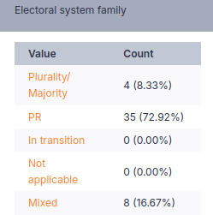
Recap: Variety in Europe
Party systems
Executive Majority
Electoral Systems
Majoritarian Mixed System Proportional
Three "families"

Slide 13
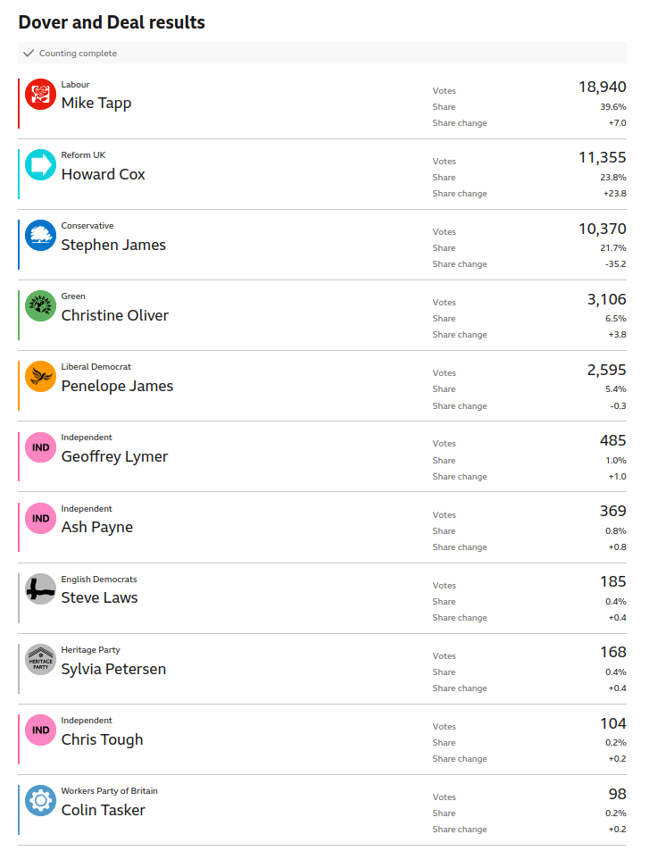
Majoritarian systems
"Plurality" Systems
First-past-the-post (FPTP)
Single candidate/party/district
DM = 1
Winner takes all
Extremely disproportional

Slide 14
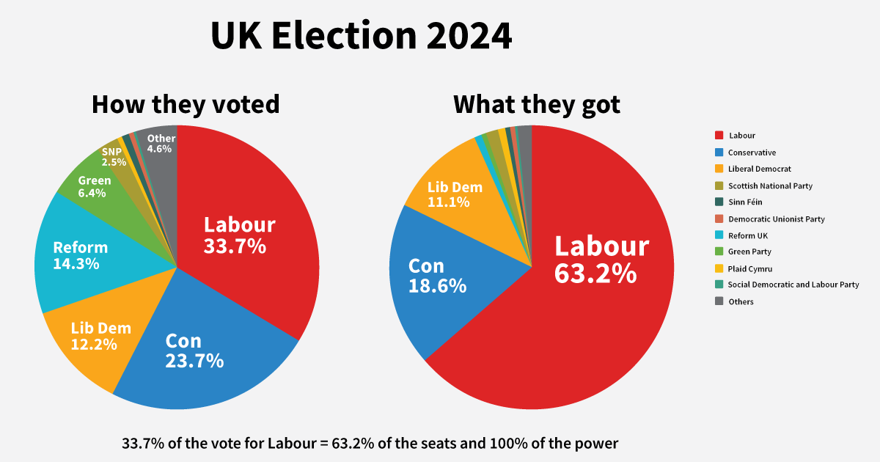
United Kingdom: Concentration of Power
+ only 20.2% of electorate share
"Elective Dictatorship" (Lord Hailsham)

Slide 15
Majoritarian systems
"Plurality" Systems
Absolute Majority Systems
First-past-the-post (FPTP)
Bloc Vote (CH upper house)
Party bloc vote (not in EU)
Two-Round Runoff Voting
Single candidate/party/district
DM = 1
Often used for presidential elections, but also French legislative elections

Slide 16
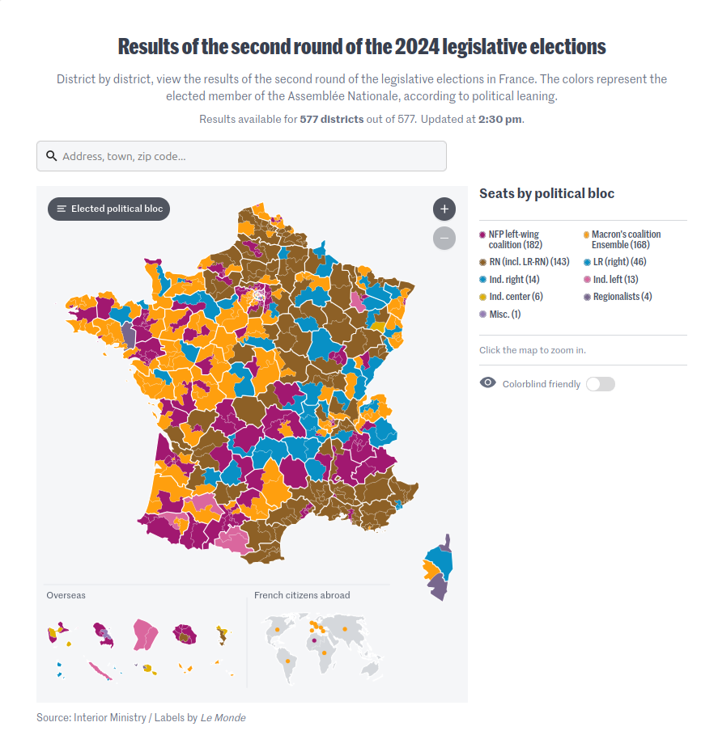
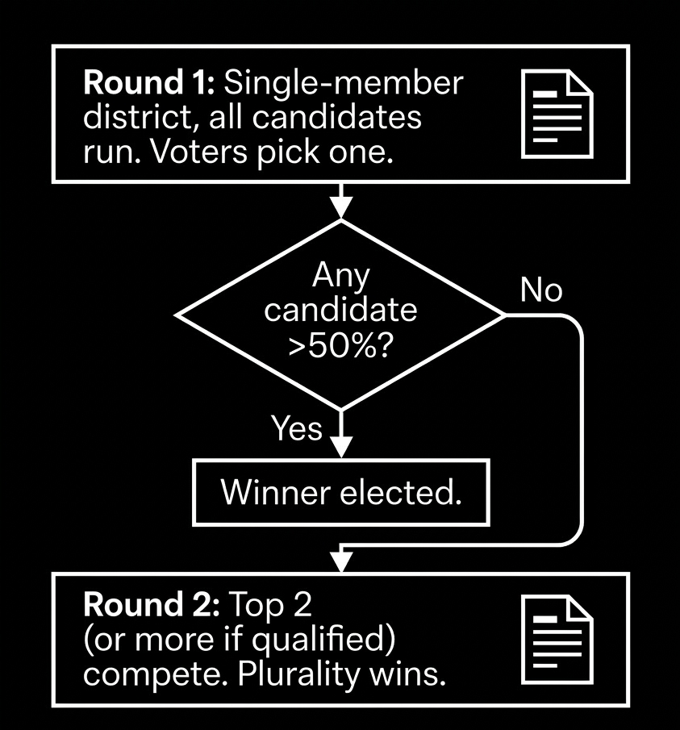
France: second round with plurality

Slide 17
Majoritarian systems
"Plurality" Systems
Absolute Majority Systems
First-past-the-post (FPTP)
Bloc Vote (CH upper house)
Party bloc vote (not in EU)
Two-Round Runoff Voting
Alternative Vote
1 candidate/party/district
DM = 1
Based on ranking of candidates
Australia + almost UK

Slide 18
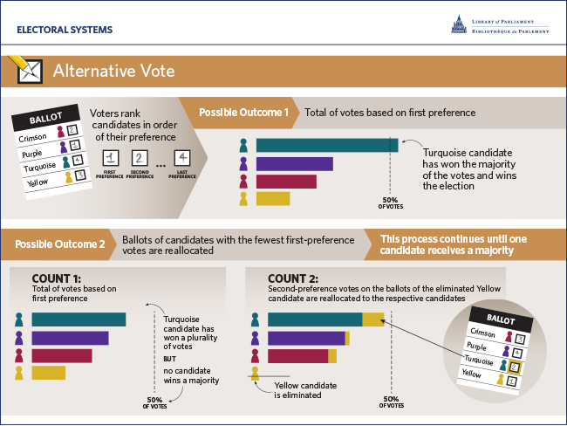

Slide 19
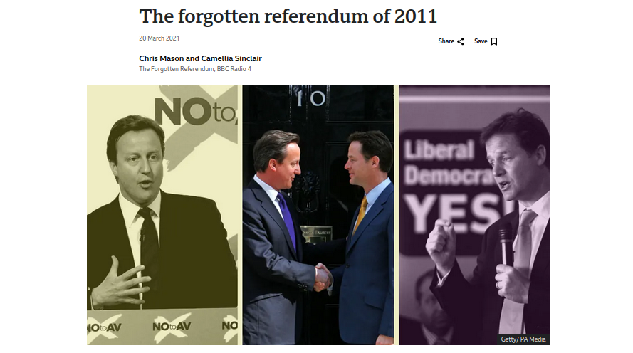
UK 2011 Referendum on Alternative Vote

Slide 20
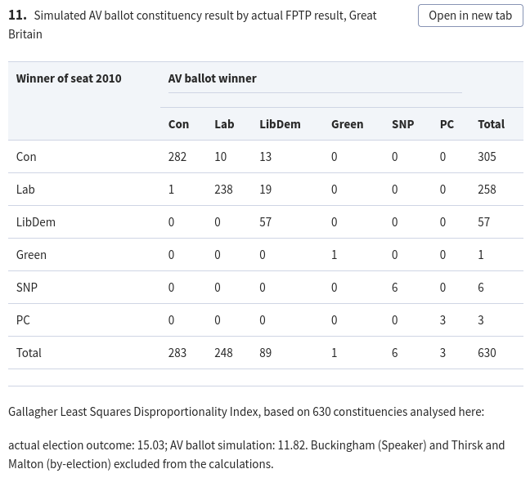
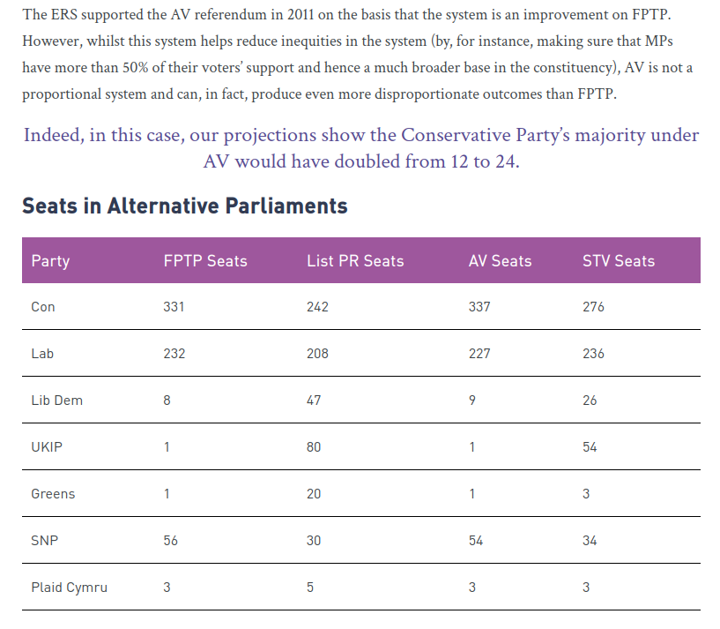
More proportional?
Yes in 2010
But not in 2015
David Sanders, Harold D. Clarke, Marianne C. Stewart, Paul Whiteley, Simulating the Effects of the Alternative Vote in the 2010 UK General Election, Parliamentary Affairs, Volume 64, Issue 1, January 2011, Pages 5–23, https://doi.org/10.1093/pa/gsq042
https://electoral-reform.org.uk/latest-news-and-research/publications/the-2015-general-election-report/#sub-section-15

Slide 21
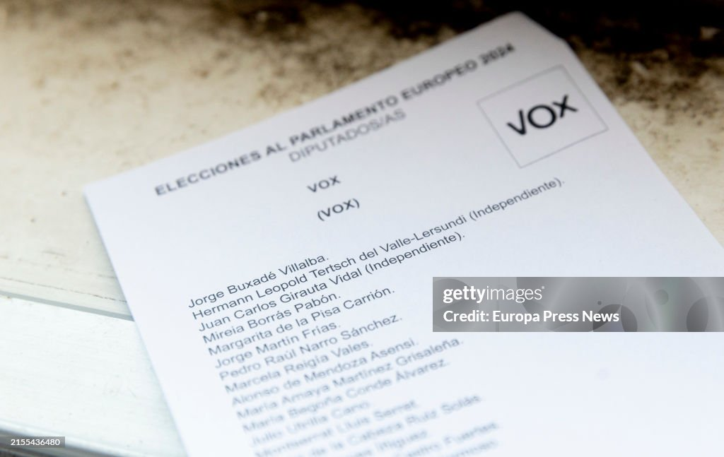
2. Proportional Systems
Party List Proportional systems
Multiple candidates per list
Usually less districts with larger DM
Three types (preference votes):
Closed list (Spain)

Slide 22
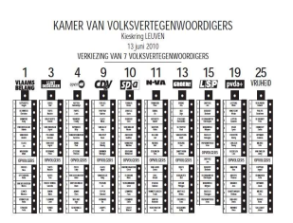
2. Proportional Systems
Party List Proportional systems
Multiple candidates per list
Usually less districts with larger DM
Three types (preference votes):
Closed list (Spain)
Semi-open (Belgium)

Slide 23
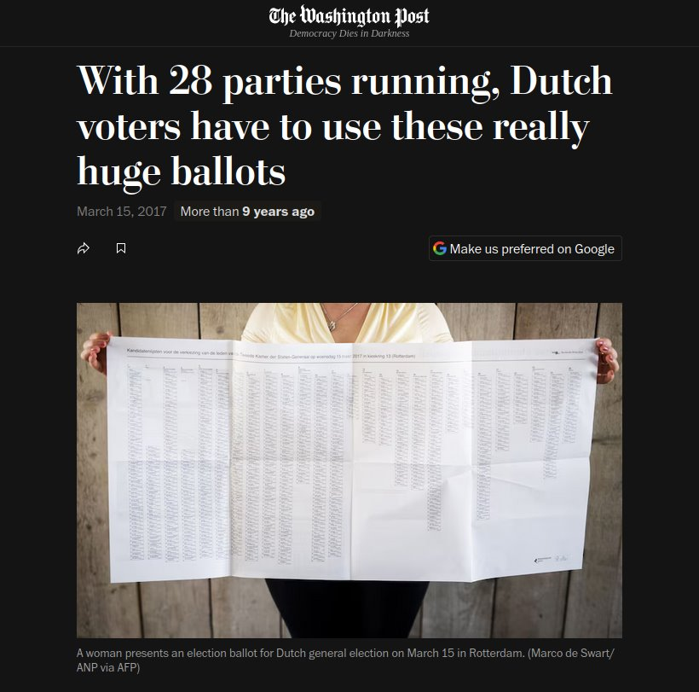
2. Proportional Systems
Party List Proportional systems
Multiple candidates per list
Usually less districts with larger DM
Three types (preference votes):
Closed list (Spain)
Semi-open (Belgium)
Open (NL)
https://www.washingtonpost.com/news/worldviews/wp/2017/03/15/with-28-parties-running-dutch-voters-have-to-use-these-literally-enormous-ballots/

Slide 24
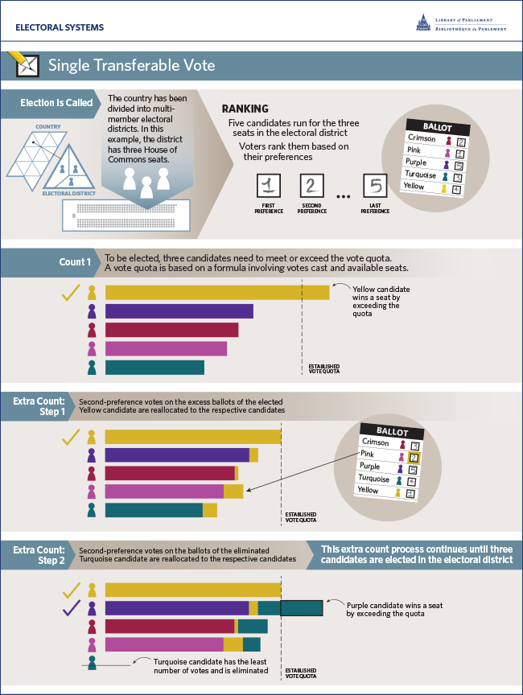
2. Proportional Systems
List-Proportional systems
Single Transferable Vote
Ireland & Malta
1<DM<5
Ranking & quota's

Slide 25
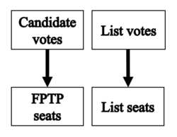
3. Mixed Systems
1. Parallel systems
Elements are separated and independent
Lithuania
Italy (Sort of)

Slide 26
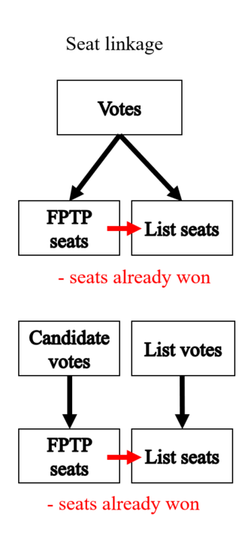
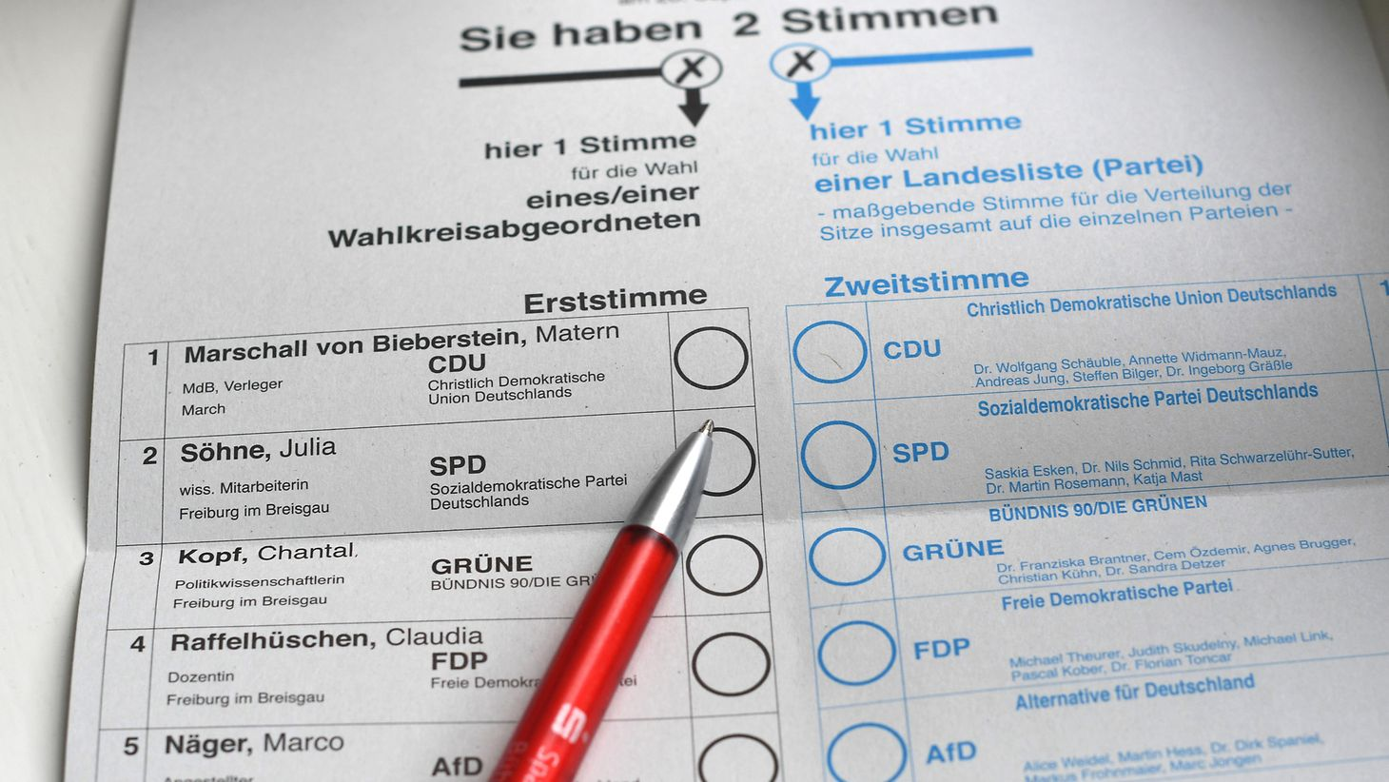
3. Mixed Systems
1. Parallel systems
2. Mixed Member Proportional
More proportional
List aspect as a correction for FPTP
Can be one vote or two votes
Germany

Slide 27
Duverger's Law of plurality voting (1951)
Countries with a plurality/FPTP system tend to have a two-party system due to a difficulty for third parties to win seats (mechanical effect), and a fear of voters for wasting their vote (psychological effect).

Slide 28
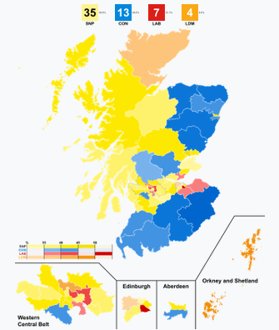
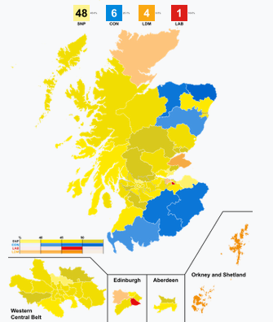
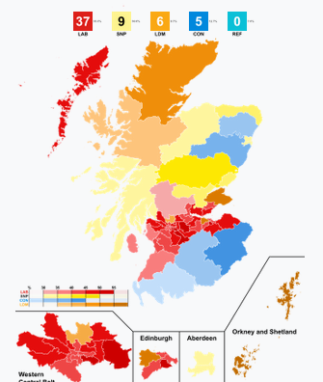
But cleavages still matter: Scotland in UK elections
2017
2019
2024
Notes:
Scottish independence

Slide 29
Duverger's Hypothesis (1951)
Countries with a two-round majoritarian or proportional system tend to have a multi-party system. Duverger (1986) would later state that that the former would result in ​many allied parties (i.e. moderate) and the latter in many independent parties (i.e. polarizing).

Slide 30
+ Electoral engineering
No two systems are perfectly similar, and minute changes happen frequently, sometimes with strong effects.

Slide 31
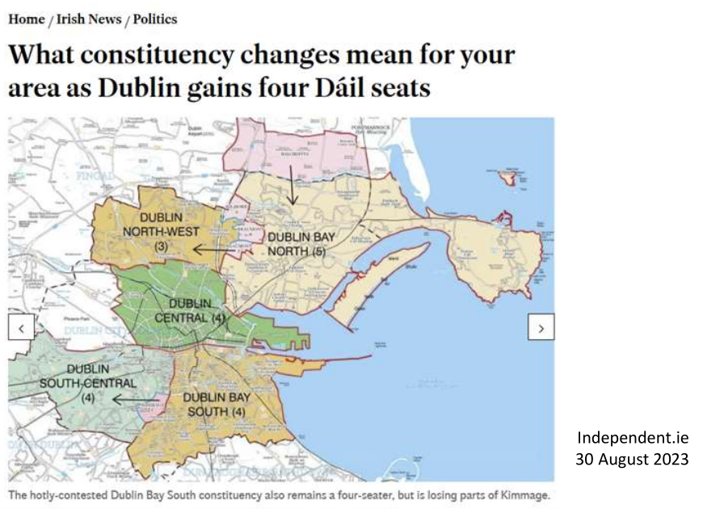
+ Electoral engineering
Malapportionment
Lack of balance in the amount of people being represented in a constituency
Can be positive, f.i. to promote representation for ethnic minorities
Ireland 2007 – 2023
Rising population since 2007
Dublin West: 30K/seat
Dun Laoghaire: 23K/seat
Changed in 2023

Slide 32
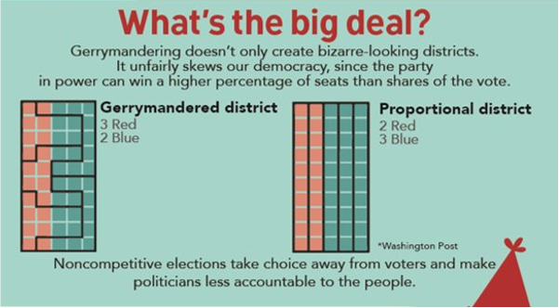
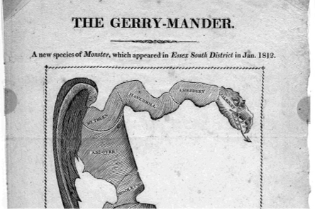
+ Electoral engineering
Malapportionment
Gerrymandering

Slide 33
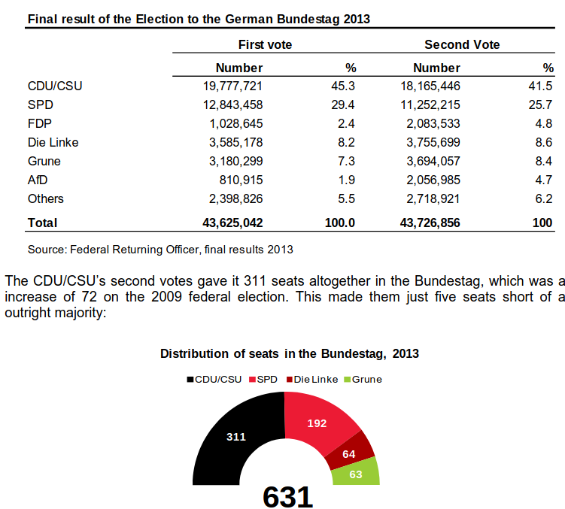
+ Electoral engineering
Malapportionment
Gerrymandering
Voting tresholds
Formal tresholds
Effective tresholds (voted needed per constituency): 75% / DM+1 (Lijphart)
Big impact on fragmentation

